Slide 1
2D Hydrodynamics
and Water Quality Model
CE-QUAL-W2
August 12, 2021

Slide 2
Types of Models
Completely mixed (0-order)
One dimensional (1-D)
Usually longitudinal
Two dimensional (2-D)
Longitudinal and vertical
Three dimensional (3-D)
Completely mixed
reactor
More
data
Deep, vertically
segmented
River-run impoundment,
longitudinally & vertically
segmented
Elongated, shallow,
longitudinally
segmented

Slide 3
Types of Models
Zero dimensional (0D) models
RECOVERY sediment and contaminant model
One dimensional (1D) models
HEC-RAS hydraulics, sediment and water quality model
Two dimensional (2D) models
CE-QUAL-W2 hydrodynamic and water quality model
Three dimensional (3D) models

Slide 4
Factors in Model Choice
Development of conceptual model
Consideration of processes that can and cannot be modeled
Selection of appropriate level of analysis (i.e., model type)
Assurance of adequate replication of in-situ processes known to be important
Trade-offs between model complexity and cost (data needs, expertise, computational cost)
What is the level of existing data?
What levels of resources/technical expertise exist?
Does model provide adequate level for decision making?

Slide 5
CE-QUAL-W2
http://www.cee.pdx.edu/w2/
Laterally-averaged longitudinal/vertical hydrodynamics and water quality model
Applicable to sloping rivers, lakes, reservoirs, and estuaries and any combination thereof
Able to model multiple water bodies and branches
Able to model any number of general constituents, inorganic suspended solids, algal, periphyton, zooplankton, and CBOD groups, and their impacts on algal/ nutrient/dissolved oxygen interactions
Used in 400 systems throughout the U.S. and the world for reservoir operations and thermal and water quality studies
Open Source

Slide 6
CE-QUAL-W2
River Section
Reservoir Section
Slope=S=tanα
x
g
z
u
w
α
u
x
z
w
Q_{out}
(Courtesy of W2)

Slide 7
CE-QUAL-W2 Hydrodynamics
Water surface elevations
Horizontal/vertical velocities
Temperature/density/ice cover routines
Vertical eddy viscosities/diffusivities
Flow/head boundaries
Downstream selective withdrawal
Pipes, pumps, spillways, gates, internal/external weirs, pump-storage
Dynamic shading

Slide 8
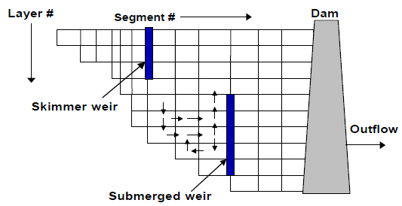
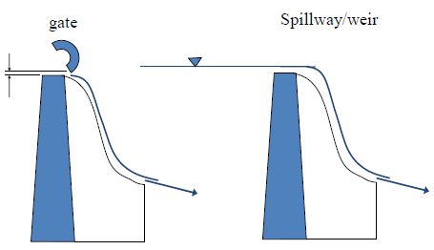
CE-QUAL-W2 Hydraulic Structures

Slide 9
CE-QUAL-W2 Hydrodynamics
Continuity Equation:
x-Momentum Equation:
z-Momentum Equation:
Laterally averaging

Slide 10
CE-QUAL-W2 Water Quality
# Arbitrary Constituents
# Inorganic suspended solids groups
CH4, H2S
N2, DGP, TDG
# labile and refractory dissolved organic matter groups (DOM, DOC, DON, DOP)
# labile and refractory particulate organic matter fractions (POM, POC, PON, POP)
Dissolved and particulate silica

Slide 11
CE-QUAL-W2 Water Quality
Alkalinity, Total inorganic carbon (TIC), PH
# different algal groups
NH₄-N, NO₃-N+NO₂-N
PO₄-P
Fe, Mn
# CBOD groups
Sediment diagenesis model
SYSTDG

Slide 13
CE-QUAL-W2 Water Quality
Kinetics
Laterally averaging

Slide 14
CE-QUAL-W2 DOM

Slide 15
CE-QUAL-W2 POM

Slide 16
CE-QUAL-W2 Ammonium

Slide 17
CE-QUAL-W2 Nitrate/Nitrite

Slide 18
CE-QUAL-W2 Phosphate

Slide 19
CE-QUAL-W2 DO

Slide 20
CE-QUAL-W2 Algae

Slide 21
CE-QUAL-W2 Algae

Slide 22
CE-QUAL-W2 Bed Sediment – First Order Approach

Slide 23
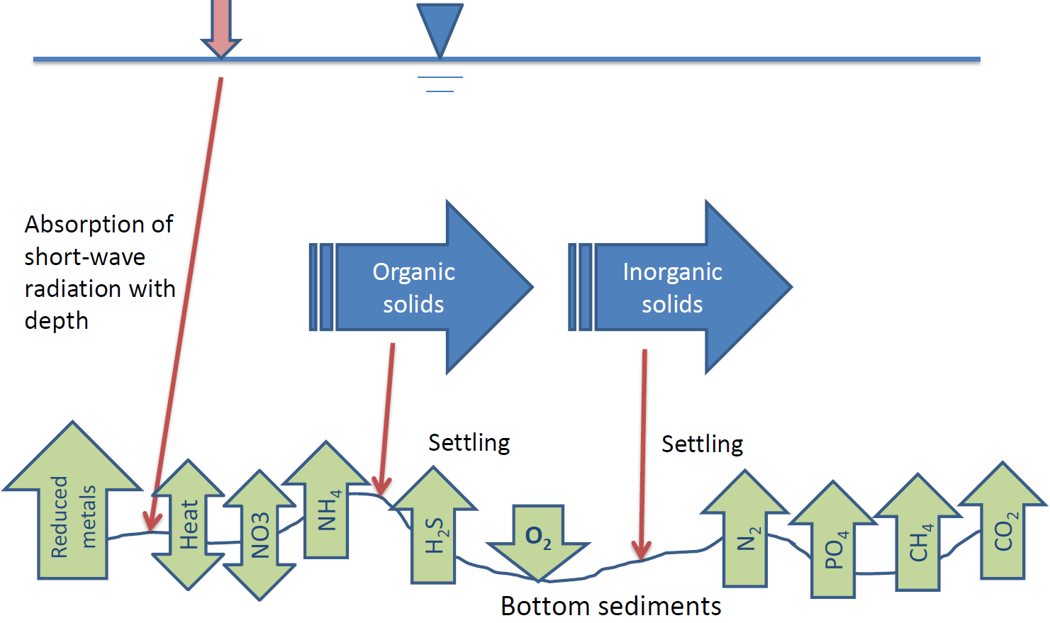
CE-QUAL-W2 Bed Sediment – Sediment Diagenesis Model

Slide 24
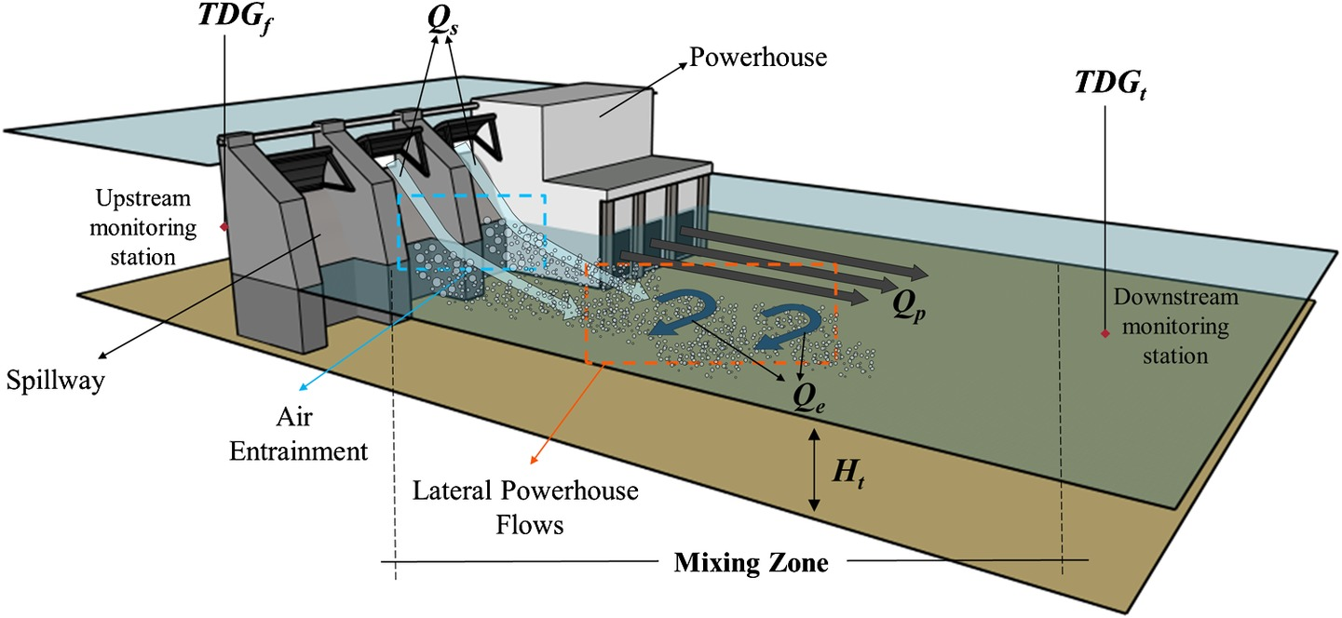
CE-QUAL-W2 SYSTDG
Estimates of forebay and tailwater TDG pressures resulting from reservoir operations.

Slide 25
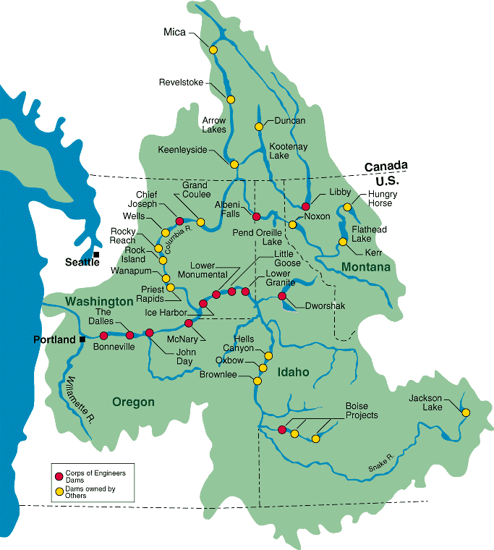
Columbia River System Operations (CRSO)
Evaluate impact of operation and configuration of federal dams on
Water temperature
Total dissolved gases (TDG)
Develop a comprehensive Environmental Impact Statement (EIS)
Courtesy of CRSO

Slide 26
Columbia River System Operations (CRSO)
Canadian System
Columbia River
Int’l Boundary
Libby
CE-QUAL W2, 2-D modeling
Grand Coulee
Hungry
Horse
HEC-RAS, 1-D modeling
Albeni Falls
Chief Joseph
model connections
Rocky Reach
Federal dam
Non-Federal dam
Rock Island
Wanapum
Dworshak
Boundary condition gage
Priest Rapids
Hanford Reach
Clearwater River
Orofino
Lower
Granite
Little
Goose
Lower
Mon.
Ice
Harbor
Snake River Anatone
Columbia River
Washougal
Bonneville
The Dalles
John Day
McNary
Courtesy of Dan Turner

Slide 27
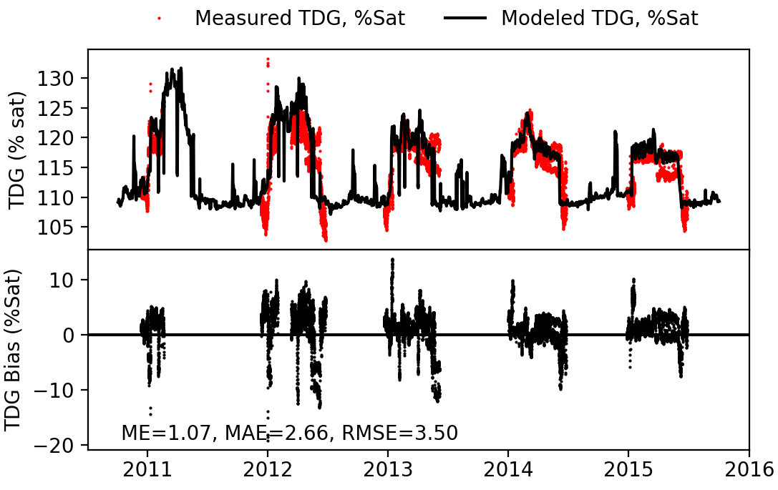
Columbia River System Operations (CRSO)
Bonneville Dam

Slide 28
Mainstem Missouri River Reservoirs
Fort Peck Dam (5th)
Garrison Dam (3rd)
Oahe Dam (4th)
Big Bend Dam
Fort Randall Dam
Gavin’s Point Dam
Water quality constituents
Temperature
Turbidity
Dissolved oxygen

Slide 29
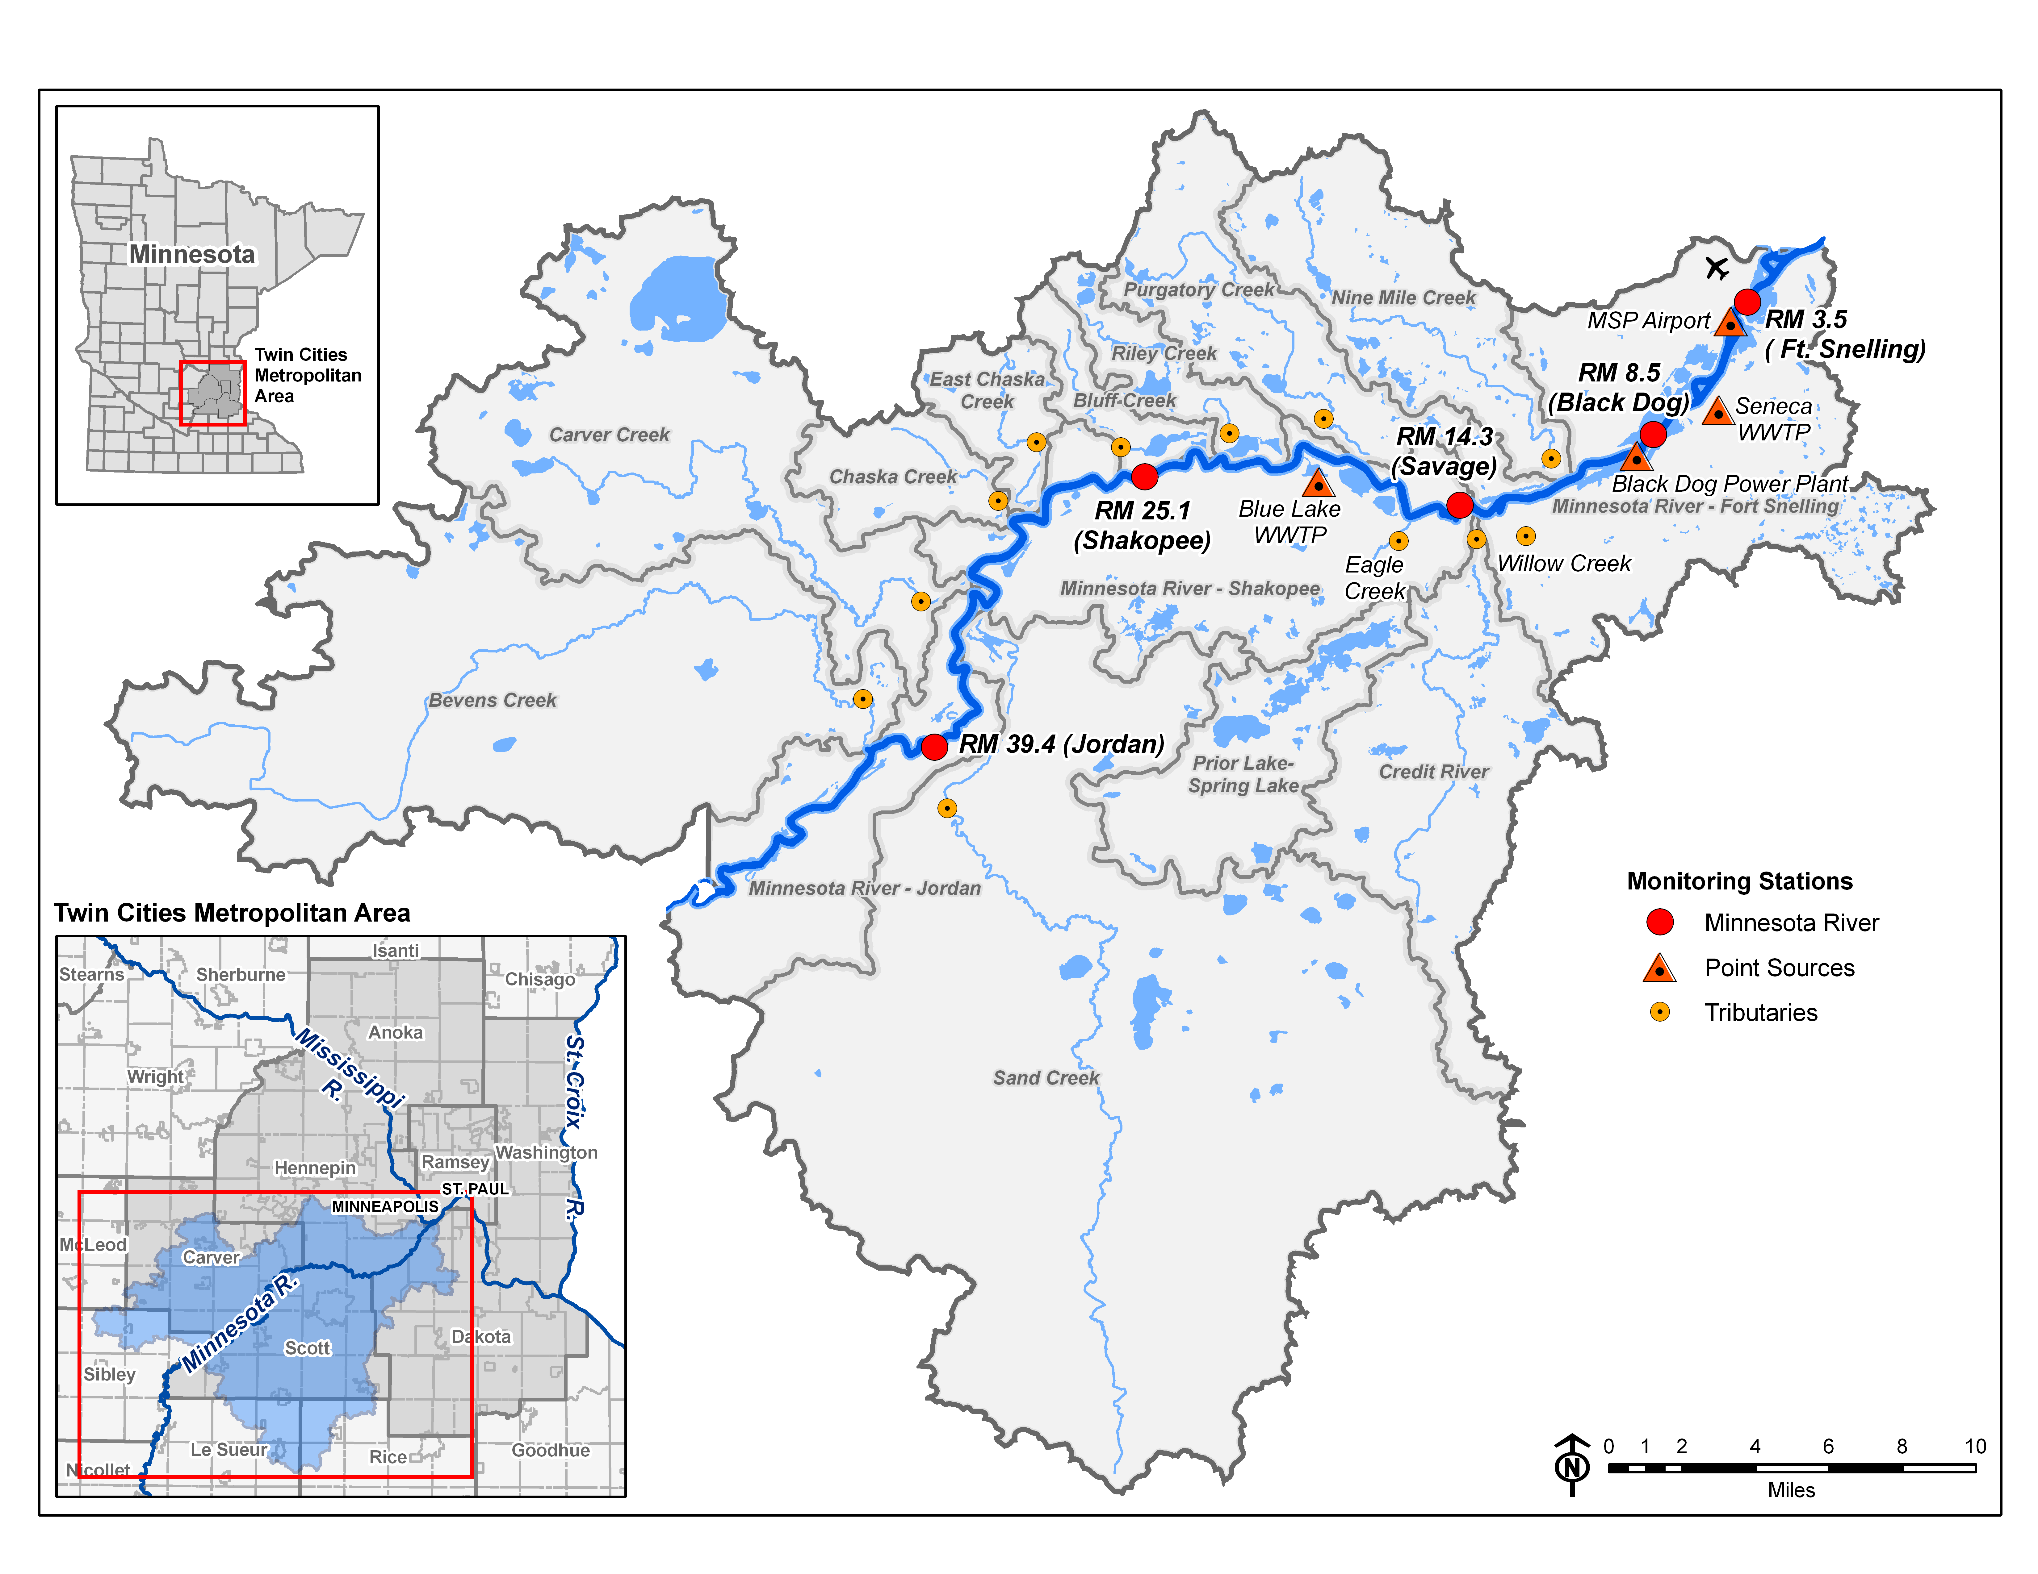
Lower Minnesota River

Slide 30
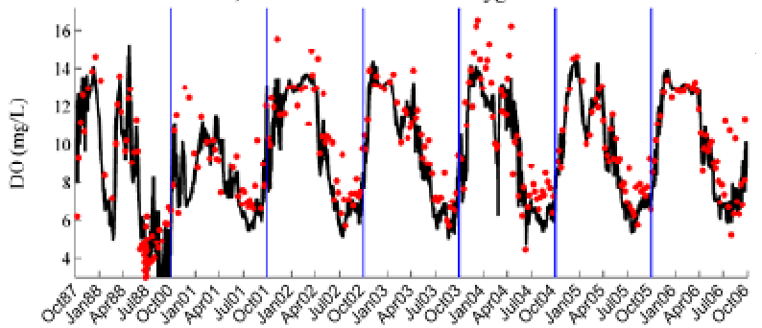
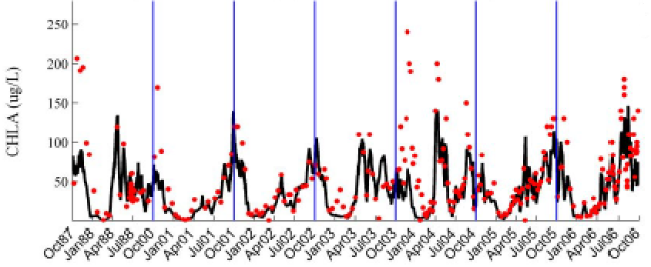
Lower Minnesota River

